Slide 1
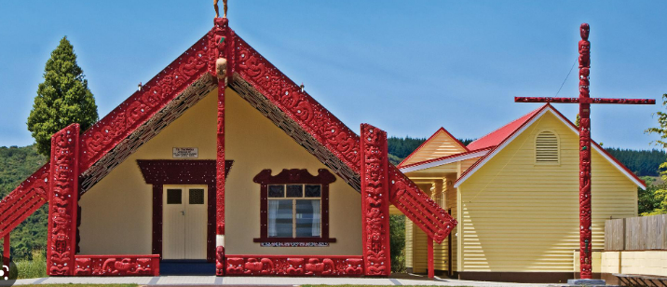
Te Kāhui Ako o ngā Kura Karaitiana Mātauranga Māori

Slide 2
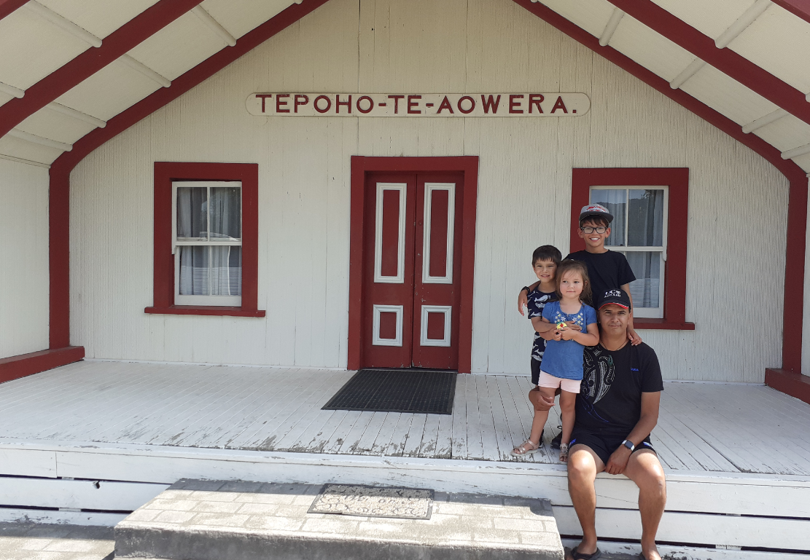
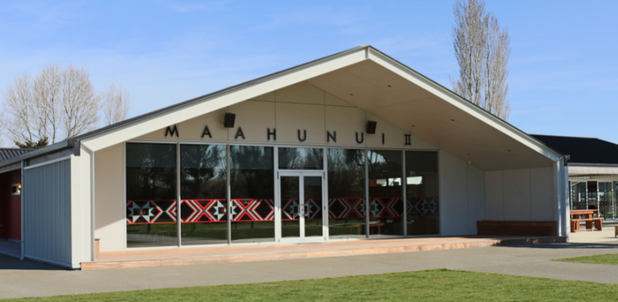
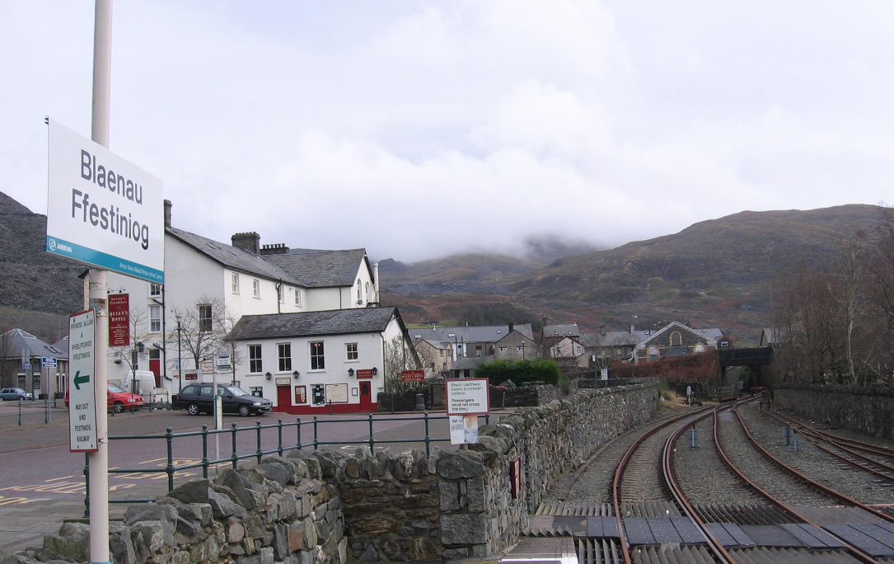
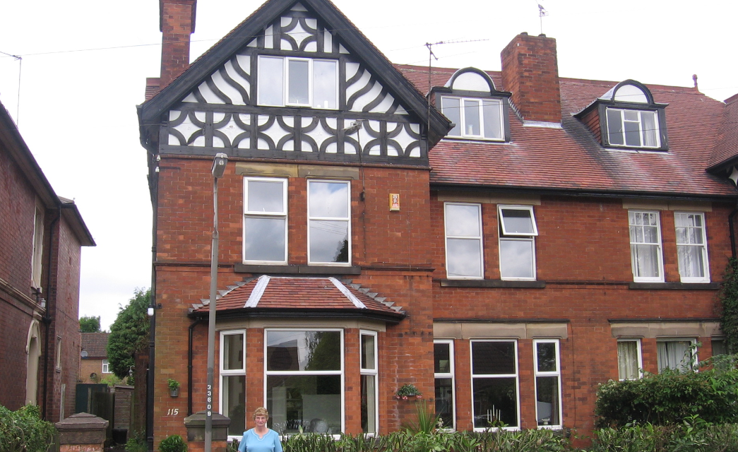
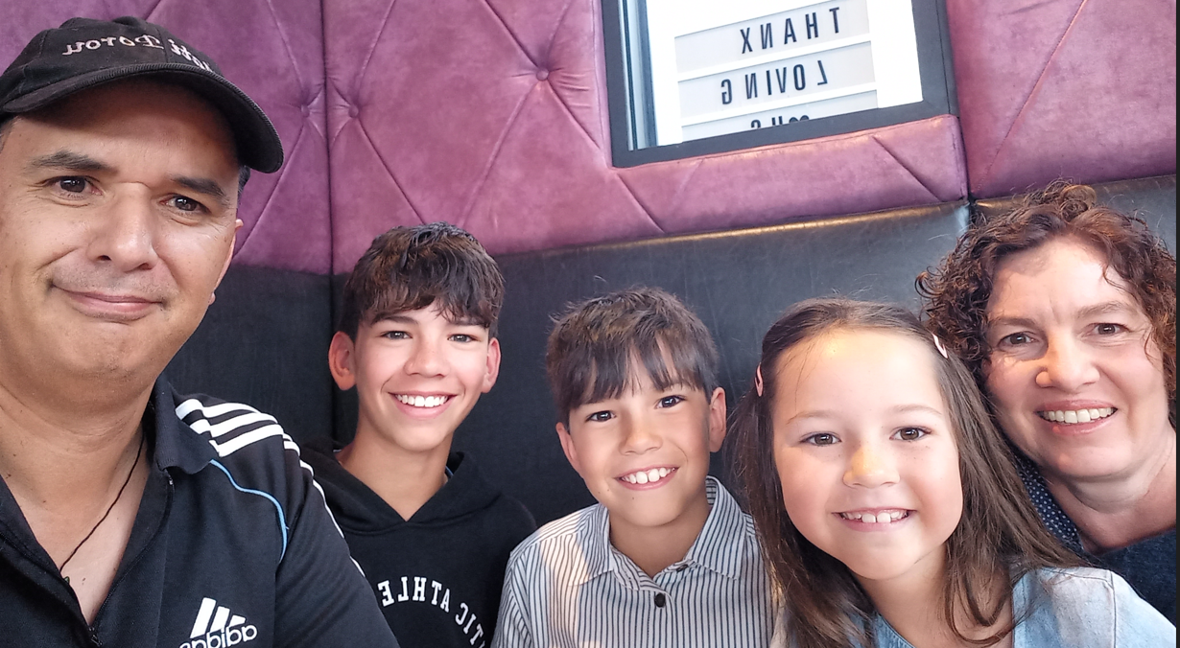
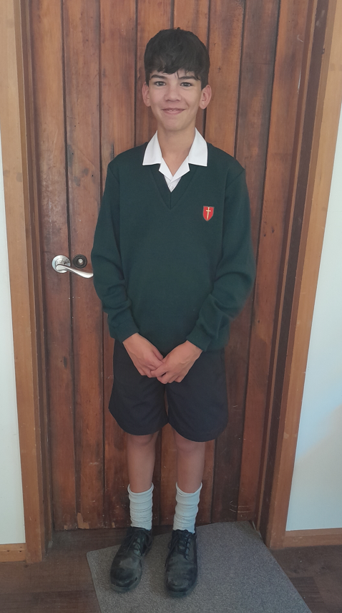
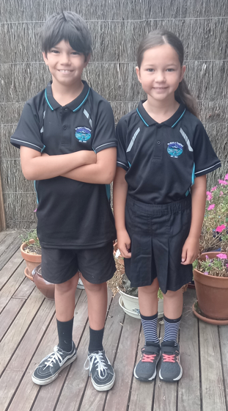
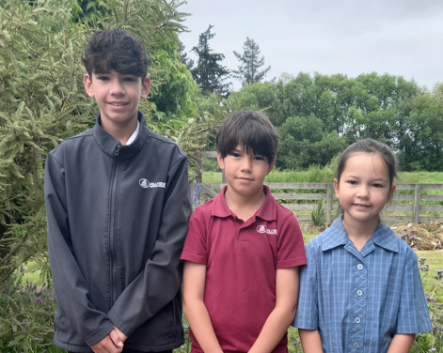
Ko wai au? (Who am I?)
Antony Nihoniho (Ngāi Tahu / Ngāti Porou / Ngāti Pākehā)
Īmēra: antony.nihoniho@canterbury.ac.nz
Ngāti Porou Ngāi Tahu Wales England
Te Tai Rāwhiti Te Wai Pounamu Blaenau Ffestiniog Derbyshire

Slide 3
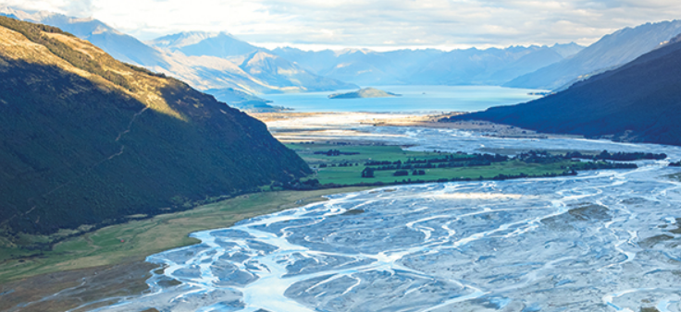
Mātauranga Māori: Why bother?

Slide 4
Unity in diversity
Relationships
Only our relationships endure.
A sign of Godly & healthy relationships: unity
What is unity?
Agreement? (unanimity) Sameness? (conformity)
Unity requires diversity
How do we maintain unity?
A free gift: lost in Eden, regained at the cross
Easy to lose: our efforts can be (unintentionally) exclusionary
Our diversity may be a vital element of our identity

Slide 5
Unity in diversity
Unity is:
Valuing the relationship more than the point of difference
Not just acknowledging diversity to allow others to express themselves as God created them, not just “you do you”
but, engaging for the sake of the relationship
Rather than a threat to unity, diversity is a necessary criteria

Slide 6
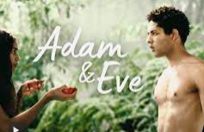
God’s creation blessing
"Be fruitful and multiply and fill the waters” (Gen 1:22)
"Be fruitful and multiply, and fill the earth and subdue it” (Gen 1:28)
"Be fruitful and multiply, and fill the earth.” (Gen 9:1)
The Table of Nations: diverse communities “with their own language” in different regions of the world. (Gen 10)
The Tower of Babel: proceeds the previous chapter, opposes God’s plan to fill the earth, “one language and the same words” (Gen 11)
Prof. Allan Bell (AUT) Reconstructing Babel (2011) challenges Babel as an affront to God which results in the curse of multilingualism. . . [instead, the issue is] people’s refusal to spread through the earth. The multilingual outcome is a positive affirmation of . . . diversity.”

Slide 7
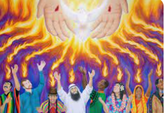
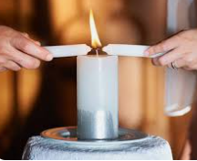
Biblical unity
Acts 15: 5: But some of the sect of the Pharisees who believed rose up, saying, “It is necessary to circumcise them, and to command them to keep the law of Moses.”
Acts 15: 8-9: So God . . . acknowledged them by giving them the Holy Spirit, just as He did to us & made no distinction between us and them
Acts 2: 6: When they heard this sound, a crowd came together in bewilderment, because each one heard their own language being spoken.
Gal 3: 28: There is neither Jew nor Gentile, neither slave nor free, nor is there male and female, for you are all one in Christ Jesus.

Slide 8
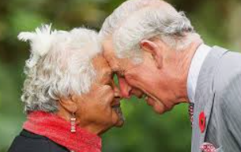
Unity in Aotearoa New Zealand
Why Māori culture?
Because as educators we should engage in the local context?
If New Zealand educators do not, who else will (or should)?
A biblical imperative to contextualize the Gospel in the local culture?
To fulfil God’s aspirations for Aotearoa New Zealand?

Slide 9
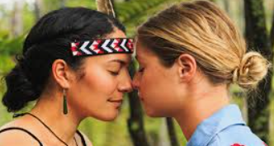
Unity in Aotearoa New Zealand
God planted Māori, Pākehā (British descendants) and tauiwi (all other nations) on this whenua
Unity not dependent on the government legislating us to pursue biculturalism and multiculturalism
The intent of Te Tiriti o Waitangi
But also, a Gospel imperative of not just acknowledging the existence of two worldviews, but actively participating

Slide 10
Mātauranga Māori: An introduction

Slide 11
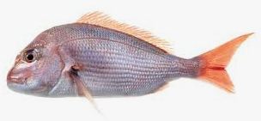
‘Traditional’ Mātauranga Māori
Relatively recent term, related to knowledge
Knowledge as a ‘thing’ is not a traditional Māori concept
Māori Marsden: like asking a fish to define water
Initially differentiated from the new knowledge of Pākehā
Mātauranga =
Knowledge brought by Pākehā: biblical knowledge
Mātauranga Māori =
Traditional Māori spirituality-infused knowledge
NB: Māori culture and Mātauranga Māori is dynamic & ever-changing

Slide 12
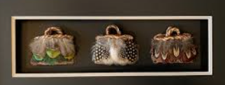
Mātauranga Māori
Some modern definitions:
A body of knowledge handed down (Whatarangi Winiata)
All knowledge, ever-expanding (Hirini Moko Mead)
Knowledge brought to Aotearoa in C13, reconstructed by this whenua, and then by engagement with Pākehā (Charles Royal)
Today, mātauranga Māori can incorporate Christianity as a
taonga tuku iho, a treasure handed down from our ancestors
e.g. te reo Māori incorporates English, it remains mātauranga Māori

Slide 13
Towards a Christian engagement with Mātauranga Māori
Mātauranga =
Knowledge of Anglo-Western culture shaped by this whenua
Influenced by Māori knowledge
For us as Christians, adheres to biblical principles
Mātauranga Māori =
Knowledge of Polynesians shaped by this whenua
Influenced by Anglo-Western knowledge
For us as Christians, adheres to biblical principles
(Mātauranga Māori not exclusive of biblical knowledge)

Slide 14
Mātauranga Māori: The mechanics A Māori worldview

Slide 15
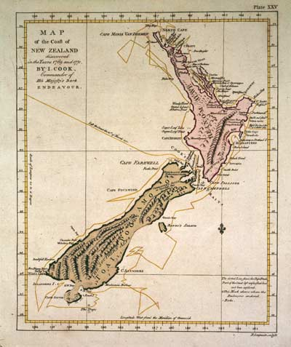
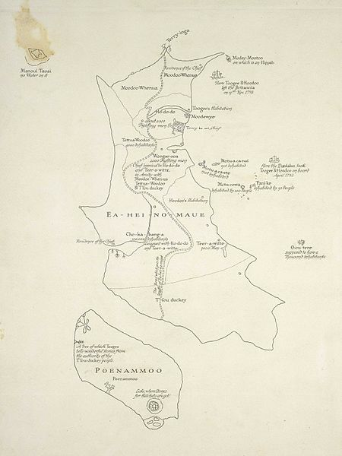
Cook’s Map, circa 1773
Tuki’s Map, circa 1793

Slide 16
Features of Mātauranga Māori
Spirituality is the ultimate reality: and permeates all
Collective identity: an individual is comprised of a collective
Place-based: identity is related to place, invoking environmental obligations
Relational: the world is connected by a universal whakapapa of relationships
Interconnected & interdependent: all elements, animate & inanimate
The natural environment as kin: reflects the Creator and shapes us
Intergenerational: the eternal past & future inform what happens today
Open: to incorporate new knowledge
Ever-changing: not static, open to reinterpreting, coping with interventions
Balanced: relationships require maintenance to achieve wellbeing
Acceptance of the unknown: accessing all knowledge is not possible
Comfort with apparent contradiction: context important

Slide 17
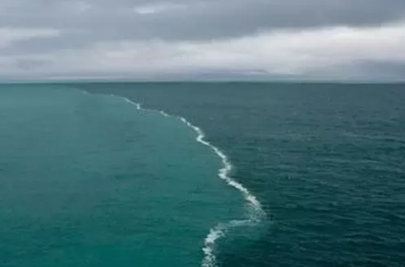
Mātauranga as an open knowledge system
If mātauranga is an ocean, then we have the privilege of two converging bodies of water reflecting God’s glory
Sir Āpirana Ngata encouraged us to place our net in the intersection of two seas of understanding
Not important where the fish originates from, all provide sustenance, as long as we acknowledge both
Te Ao Pākehā
Te Ao Māori
Open: to incorporate new knowledge

Slide 18
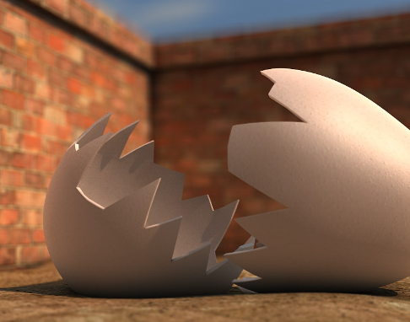
Impact of colonization on mātauranga
An impression Māori culture is frozen in time
Knowledge reconstructed: what is valid & relevant: oral, stories, faith?. . . empirical truth
Hirini Moko Mead: Mātauranga Māori like Humpty Dumpty, needs reconstruction; but is continually changing
For us as Christians, allowing the Gospel to determine what should be held on to, how to engage with new technology
Ever-changing: not static, reinterpretating, coping with interventions

Slide 19
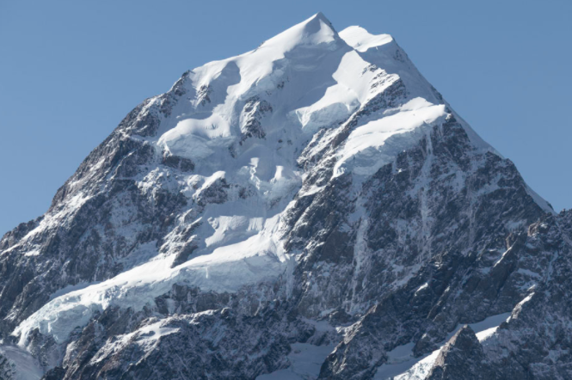
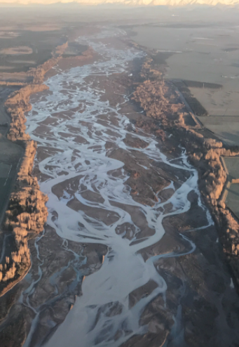
Our collective identity
Framed by whakapapa
Atua
Tūpuna
Waka
Iwi
Hapū
Whānau
Tangata
God
Ancestors
Multiple tribes
Tribe
Sub-tribe
Family
Individual
Spirituality is the ultimate reality: and permeates all.
Collective identity: an individual is comprised of a collective
Place-based: identity is related to place, invoking kinship obligations

Slide 20
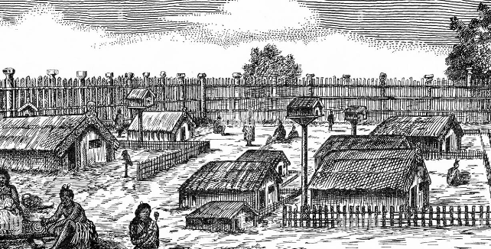
Identity related to place
Mātauranga Māori: is concerned with our relationship with the natural environment and our connection to place.
Christian Mātauranga Māori: God ‘plants’ us in a particular place that shapes our identity; revealing Himself in general revelation, the importance of land & place in the OT.
Application of MM: Connecting learning to local places and the stories of learner’s whenua.

Slide 21
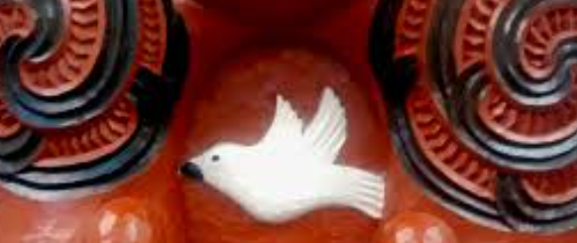
Māori creation narratives
Mātauranga Māori
Māori use stories & multiple literary devices to communicate knowledge, values, custom
Akin to parables, Aesop's fables, poetry, novel, movies etc.
How do we engage as Christians?
God as the starting point: what did He inscribe into Māori culture in preparation for the Gospel?
(Not syncretising Māori spirituality with the bible)
But, can we find evidence of what God was doing in Aotearoa before the name of Jesus was known, preparing Māori hearts?

Slide 22
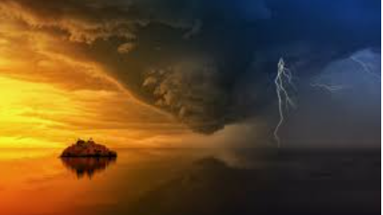
Māori Cosmology
Te Korekore:
the void, unlimited potential, seed-bed of creation
Te Pō:
the darkness of night, the sky & earth (Ranginui & Papatūānuku) formed
The realm of potentiality where everything existed in balance: no gender as male & female* were as one; sky & earth lay as one; no day or night
But, inertia: no room for movement
*Similar to theologians who posit gender did not exist until Eve was created.

Slide 23
The creation narratives
Te Ao Mārama:
Light, day emerged after a disruption: unity broken, a wrenching of sky from earth, male from female
Mana flooded in: spiritually endowed giftings ignited, relationships engaged in diversity
But also tension, between parents & children, siblings fought, authority challenged
Relationships require a balancing act: someone or something to return the unity in diversity that once was
Māori response was the laws of tapu and utu

Slide 24
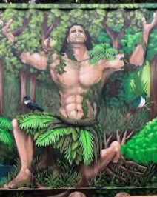
Atua (in literature)
Multiple conceptions (some that contrast!)
a god or gods, deity
but (!) not specifically god as in English
supernatural, spiritual beings with supernormal powers
an ancestor with continuing influence
a demon, ghost, or an object of superstitious regard
a supreme Atua, Io
Māori engagement back in the day (some that contrast!)
acts of homage, ritual chants, material offerings made, a form of worship
but (!) not worshipped like a deity but revered
karakia that might be pre-emptory and demanding

Slide 25
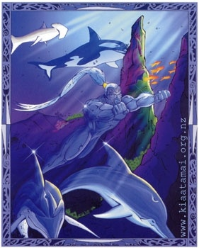
Atua
How can we think about Atua?
Evidence of the inseparable nature of the spiritual & physical realms
That Māori acknowledge spirituality as the ultimate reality
That Māori ascribed responsibility for the origins of the world to something beyond
That Māori witnessed and experienced power & energy of environmental features and attributed names and status to them
Why & how do we engage as Christians?
To educate our children and parents when they encounter them
Recognize stories of atua and ancestors contain mātauranga including technical knowledge, morals and values
Māori culture is founded on spiritual values that reflect biblical principles

Slide 26
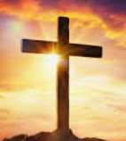
Māori creation narratives
How do we engage as Christians?
God as the starting point: what did He inscribe into creation narratives in preparation for the Gospel?
At the beginning of the world, potentiality brooding
Movement from unity in diversity to an upheaval that wrenched apart the fabric of creation
Relational fracturing first in families: siblings fought, children rebelled, parents separated
A unifying act required: Jesus the ultimate utu
Application
Movement from potentiality to form in the darkness, to enlightenment
e.g. the process of learning, knowing Jesus

Slide 27
Mātauranga Māori: How do I engage?

Slide 28
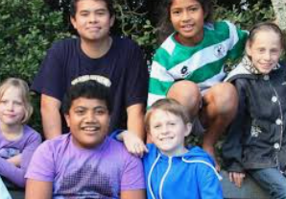
Synergies with Mātauranga Māori
A goal of Christian education:
to identify, cultivate, celebrate and enhance the God-given gifts and abilities of each pupil (Hillview Christian School)
According to Charles Royal (Māori academic):
for children to experience mana: to act according to God’s will and intent for their lives
to identify, acknowledge and practise their spiritual giftings (mana is enacting the will of the atua)
Notes:
e.g. Te Whare Āwhero

Slide 29
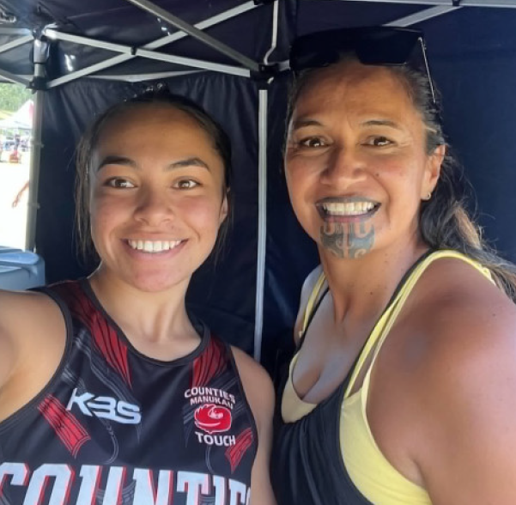
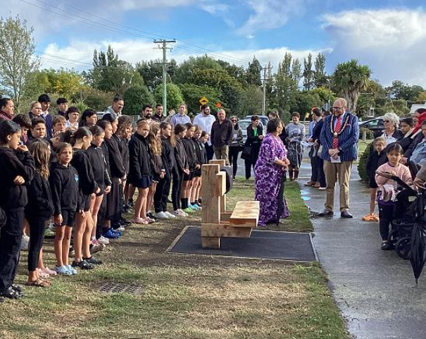
Engaging with Mātauranga Māori
e.g. Kura Kaupapa (Forbes, “How Kura Kaupapa works,” 2024)
Identity from people and place
Whānau participation
Relationship with the local natural environment a priority
Kapa haka as a teaching tool: learning reo, whakapapa
e.g. Te Kura o Tuahiwi
Celebrates identity
Supports whānau, kaumatua, participates in the life of the community & marae
Notes:
e.g. Te Whare Āwhero

Slide 30
Engaging with Mātauranga Māori
Build relationships with mana whenua & serving in Christian love Māori iwi, kura, kōhanga reo, kapa haka rōpū.
Engage in local histories and whenua (land).
Cite Māori people and achievements.
Determine identity markers for all tamariki and involving those in your teaching practices, examples.
Ensure Māori culture is felt, seen and heard.
Work in partnership with whānau, utilizing “fear of the aunties”.
Work with te taiao, the natural environment as much as possible.
Prioritise whanaungatanga, building relationships.
Incorporate mana, tapu, hau, utu etc. as expressions of Godly principles.
Demonstrate manaakitanga, welcome visitors with kai and hospitality.
Establish connections that allow you to seek advice when needed
Te Pūruatanga: we are here to support your engagement
Notes:
e.g. Te Whare Āwhero

Slide 31
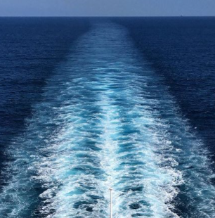
Engaging with Mātauranga Māori
Te Rongopai (The Gospel)
Te Tiriti o Waitangi Kawenata (A Covenant)
Māori Language Commission (2021): Mā tātou katoa te reo Māori e whakaora. If te reo Māori is to survive, non-Māori must learn and speak the language.
Unity depends on EVERYONE engaging in a Māori worldview and a Pākehā worldview, experiencing the richness of both.

