Slide 1
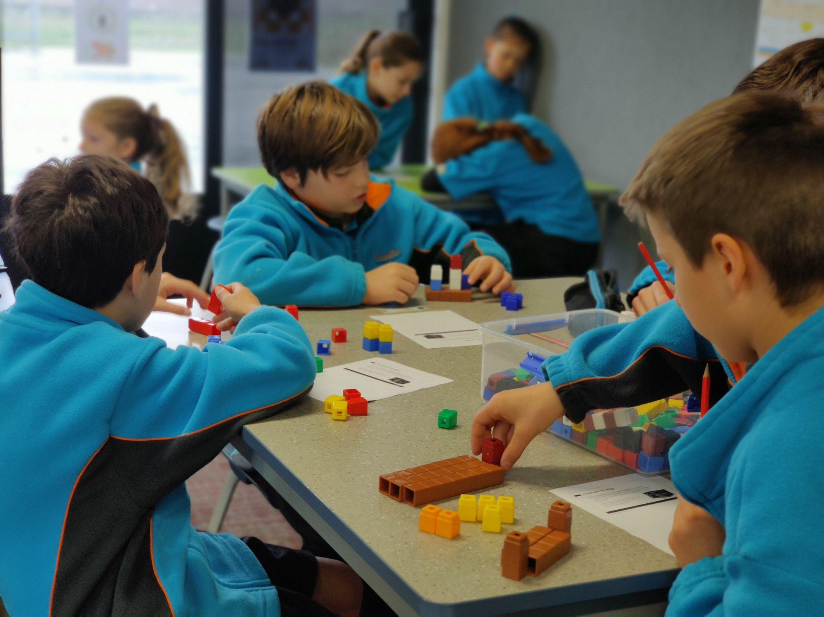
CEN Kāhui Ako PLD

Slide 2
CEN Kāhui Ako PLD
Session Outline
Overview
3.00 Connect over kai
3.15 Welcome & Karakia
3.15 Whakawhanaungatanga
3.35 Activity - 4 Square Connections
4:05 Activity – Examining Practice
4:25 Feedback form & farewell

Slide 3
CEN Kāhui Ako PLD
Maths & Statistics
Karakia
Access from the CENCOL website
www.cencol.co.nz
Username: cencolguest
Password: Network

Slide 4
CEN Kāhui Ako PLD
Maths & Statistics
Karakia Timatanga
A printable from the CENCOL website

Slide 5
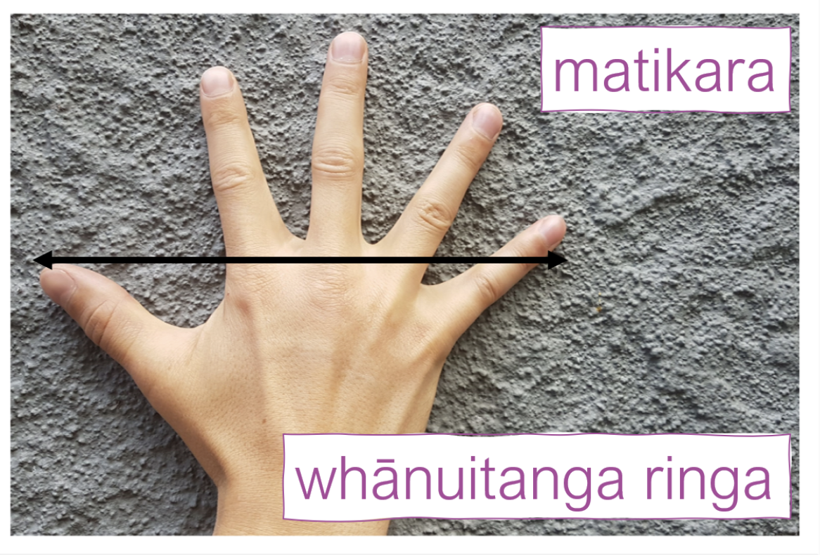
Whakawhanaungatanga
Inenga
(Traditional Māori
Measurement)
Using the cards, explore how these traditional Māori measurements could be used.
Then, complete a ‘find someone who’ card using the inenga measurements as a way of connecting with others in the room.
Discuss different ways to use these cards.

Slide 6
Whakawhanaungatanga
Inenga
(Traditional Māori
Measurement)
These links will be up on this slide on the website for teachers to access.
Link to Motat Measurement
Motat Teacher Resource including slide show on Inenga
Find Someone who

Slide 7
Activity: Compare & Contrast
Our thoughts
4 Square - 1st Quadrant
What do you see as the key purposes of mathematics?
How would you describe mathematics?
Write your word brainstorm in the first quadrant.
5 minutes

Slide 8
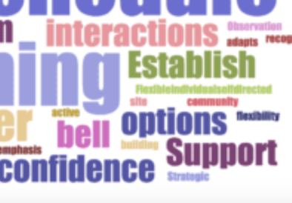
Activity: Compare & Contrast
 | Purpose Statement
Our thoughts
2nd Quadrant - Purpose Statement
Scan the ‘Purpose Statement for Mathematics and Statistics’
to find its key ideas about the purpose of maths. Write the words you find in the second quadrant.
5 mins

Slide 9
Activity: Compare & Contrast
 | Purpose Statement
God’s Purpose
Our thoughts
3rd Quadrant - God’s Purpose
What do you think God’s purpose is for mathematics and how do we bring those ideas into the classroom?
Discuss with your buddy or group and write in the 3rd quadrant.
5 mins

Slide 10
Activity: Compare & Contrast
 | Purpose Statement
God’s Purpose | So what, Now what?
4th Quadrant - So what, Now what?
Draw lines across quadrants to make connections.
Discuss the following:
What words were in common?
What resonated with you?
What surprised you?
Can you find new ways to teach a mathematical Christian perspective?
Fill in So what, Now what
Our thoughts

Slide 11
Activity: Examining Practice
The ‘Mathematics and Statistics Guide for getting started’ makes this statement.
“The ‘Do’ practices bring back explicit mathematical and statistical practices that were lost in The New Zealand National Curriculum (2007). “
We are going to use this statement to examine practice in the old and new curriculums.

Slide 12
Activity: Examining Practice
Look at the Knows & Do’s for your phase. Discuss what are you already Do - ing?
Look at the 2007 AOs .
What are the changes and what is the same?
Record your discussion on paper.
How does your “So what, Now what” connect/relate to this discussion?

Slide 13
Some ways of organising your thinking and discussion…
What’s the same? | What has changed?
What’s Interesting
Connections
to So what, Now what

Slide 14
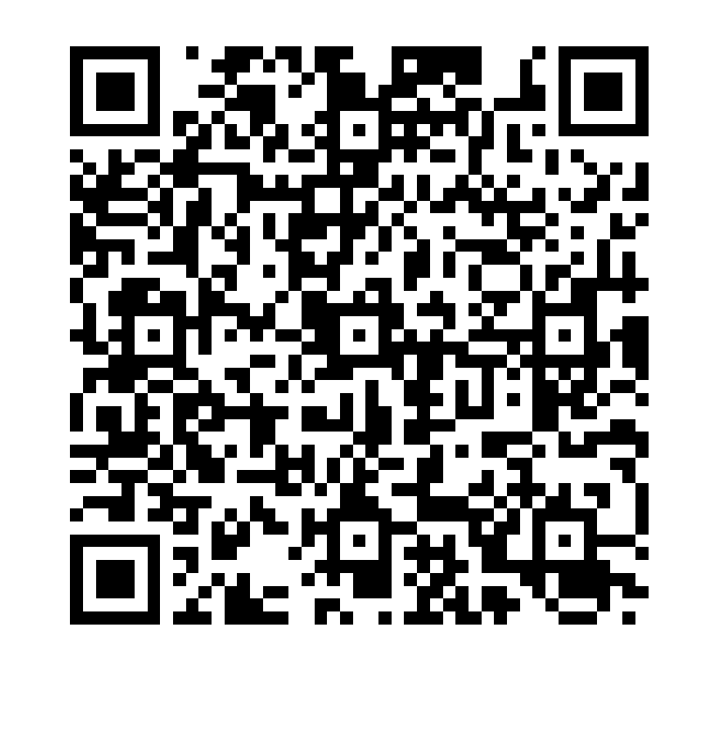
Feedback Form
Scan the code and fill in the form

