Slide 1
CO-REQUISTE PLANNING SESSIONS
Wero | Challenge
2023 = the year to increase participation or make a start

Slide 2
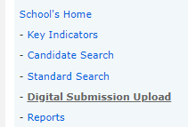
Depending on the standard, external digital assessment currently means one of these two methods:
doing the external in Assessment Master
or
a Digital Submission via Provider Login

Slide 3
External digital assessment possibilities for 2023:
LIT NUM | TRM TP Co-requisite
Do some NZQA external exams digitally [see exam TT]
School/students enrolled in L1 pilot standard(s)

Slide 4
LIT NUM | TRM TP Co-requisite
Literacy and Numeracy | Te Reo Matatini me te Pāngarau
The ‘co-requisites’ are CAAs (Common Assessment Activities) delivered digitally
Unit Standard | Title | Code | Assessment Event One | Assessment Event Two
US 32403 v1 | Literacy | Reading | LITR | 12-16 JUN = T2:Wk8 | 30 OCT-3 NOV = T4:Wk4
US 32405 v2 | Literacy | Writing | LITW | " | "
US 32406 v2 | Numeracy | NUME | " | "
US 32414 v1 | Te Reo Matatini | MATA | " | 6-10 NOV = T4:Wk5
US 32412 v1 | Pāngarau | PANG | 6-9 JUN = T2:Wk7 | 30 OCT-3 NOV = T4:Wk4

Slide 5
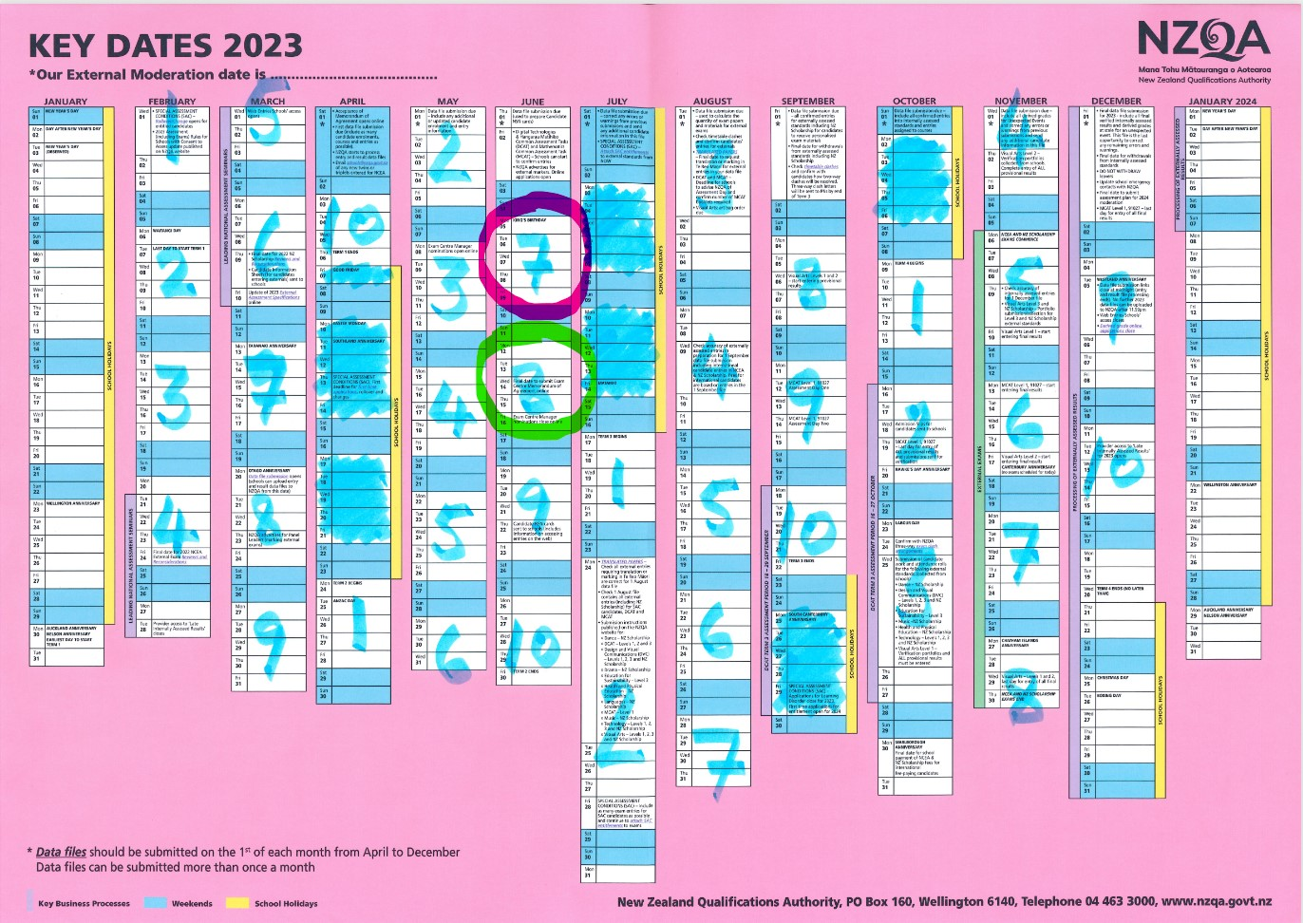

Slide 6
Getting your school ready for LITNUM | TRMTP:
How many students will be entered for LITNUM | TRMTP?
The guideline is to ‘assess when ready’ i.e student has control of curriculum level 4 and is ready to work at curriculum level 5.
Examples:
Some Year 10 classes
All Year 10s
Some Year 11 classes or students
Some Year 9s if they are ready
Remember that the Co-requisite is mandatory in 2024.

Slide 7
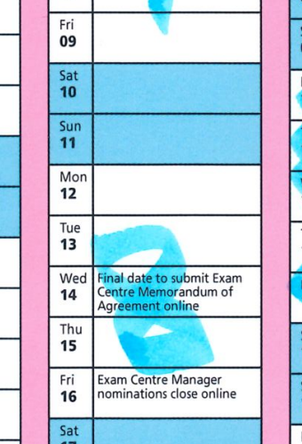
Getting your school ready for LITNUM | TRMTP:
Check your school calendar and book venue(s) for the three separate CAAs based on number of students (including students with SAC).
Consider the student perspective when choosing days e.g one per day, not using a Monday or a Friday?

Slide 8
Getting your school ready for LITNUM | TRMTP:
Enter students into the standards via the data file from your SMS. Can choose which assessment event. 1st April is your first data file opportunity. If your entries change then simply do another data file. Include 'Sort Key’ (see next slide).

Slide 9
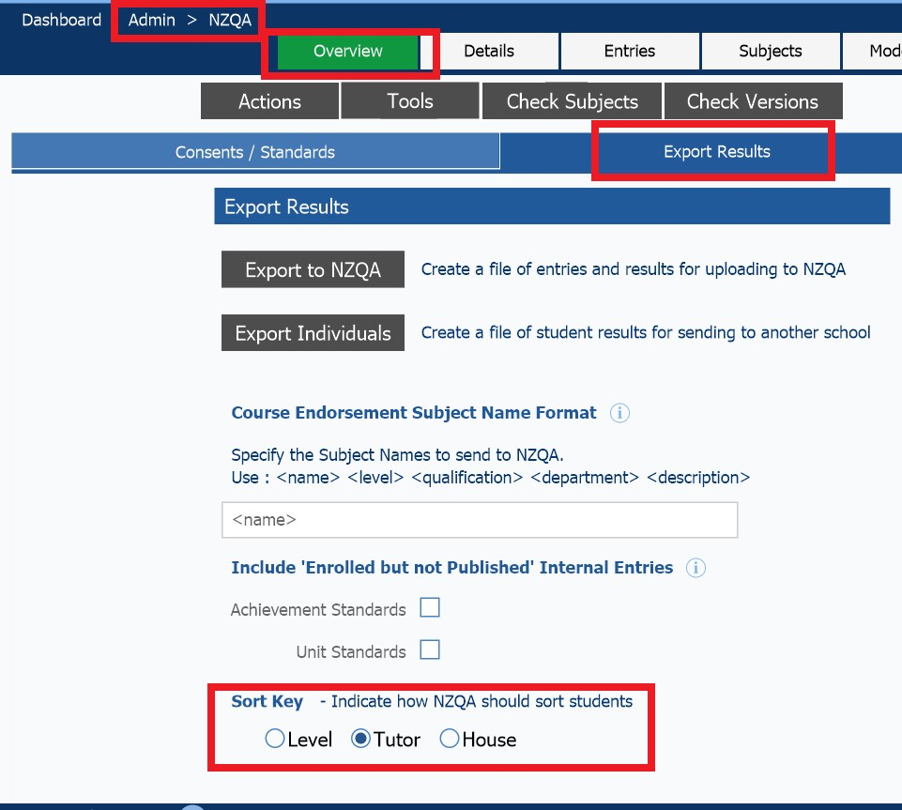
What is a 'Sort Key'?
When you add student enrolments, your SMS should have a field like a student Sort Key or Sort Code. In this field you can add a code that indicates how NZQA should sort your student information for things like NSN cards and exam entry slips. For example, you can add a form class code so that when the cards and slips arrive, they are in that ‘Sort Key’ order. If this is setup in your SMS before you make entries, the sort key will come through to AM to use. (You can set it up later and upload your entries file again.) The sort code is an alphanumeric field (max. 6 characters long).
If you have any questions about setting up this field, please talk to your SMS vendor. To the right is an example from KAMAR.
You will then be able to find students in that ‘Sort Key group’ and allocate them into a room using the ‘bulk update’ functionality. This will save time when organising large numbers of students. Instructions on how to do this will be included in the 2023 Supervisor guide. The guide will be available in the School Provider Login in April.

Slide 10
Getting your school ready for LITNUM | TRMTP:
Meet with key staff (if you are fortunate enough to have such staff) – IT, AP/DP Day-to-day Operations, database manager, learning support co-ordinator.
[ECMs will get AM training later in the year]
Inform students, parents and staff.

Slide 11
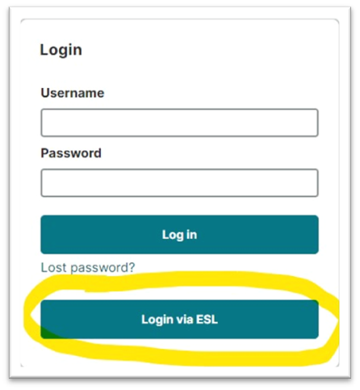
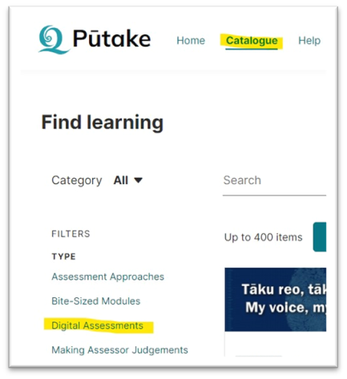
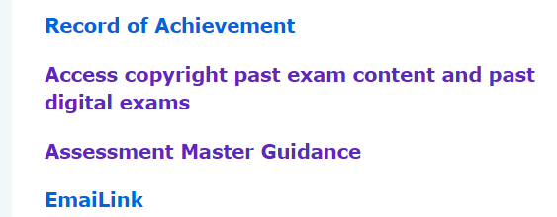
Getting your school ready for LITNUM | TRMTP:
Familiarize yourself with Assessment Master by reading the training manual and doing the training modules (available in May via Pūtake, the NZQA Learning Management System).
Note that Administration and Supervisor logins will be emailed to you in May based on your entries file. There is a link to the AM guides in the General Security area of the NZQA Provider Login.

Slide 12
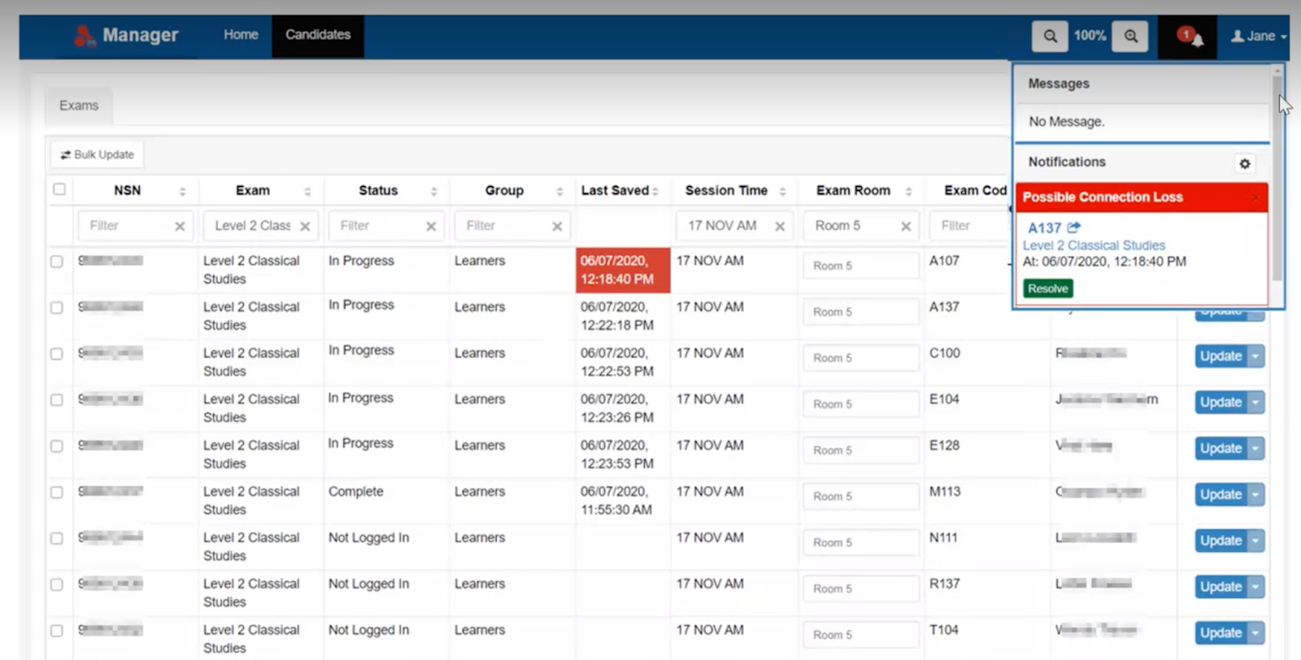

Slide 13
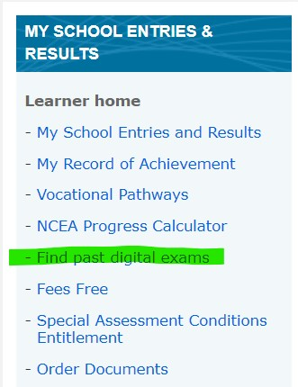
Getting your school ready for LITNUM | TRMTP:
Have a lesson where students create and use their NZQA login and do a past digital paper to practice using the assessment platform.
Be deliberate about this e.g get Year 10 Maths teachers to check off a class list of students logging in. Could be an assignment in Google Classroom.

Slide 14
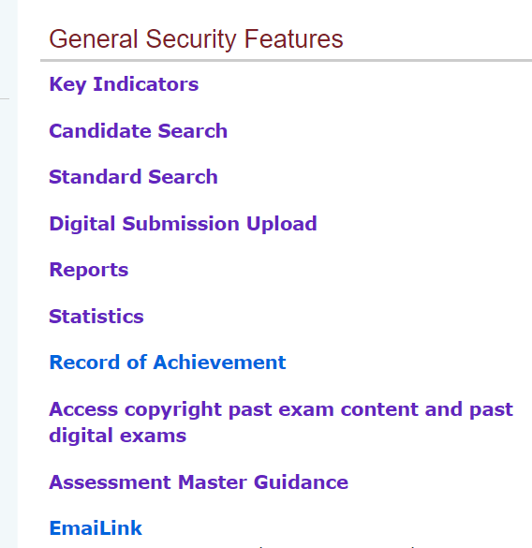
Digital assessment preparation
Device, browser and operating system requirements or
Getting your school ready
Student preparation
NZQA Learner Login
Training in Assessment Master available May, Term 2

Slide 15
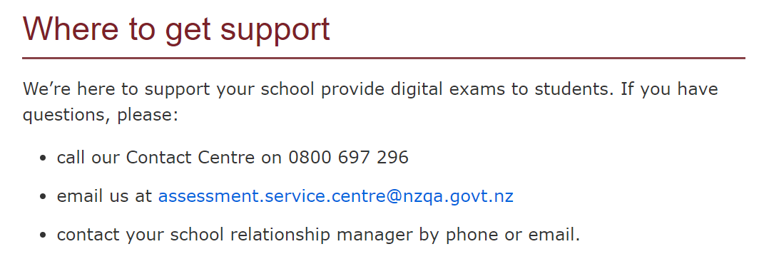
Scroll to the bottom of this link to see where to get support.
Get your school ready for digital exams » NZQA
If calling the Contact Centre during an assessment, make it clear that you have an assessment issue and need support so that a solution can be found as soon as possible.

Slide 16
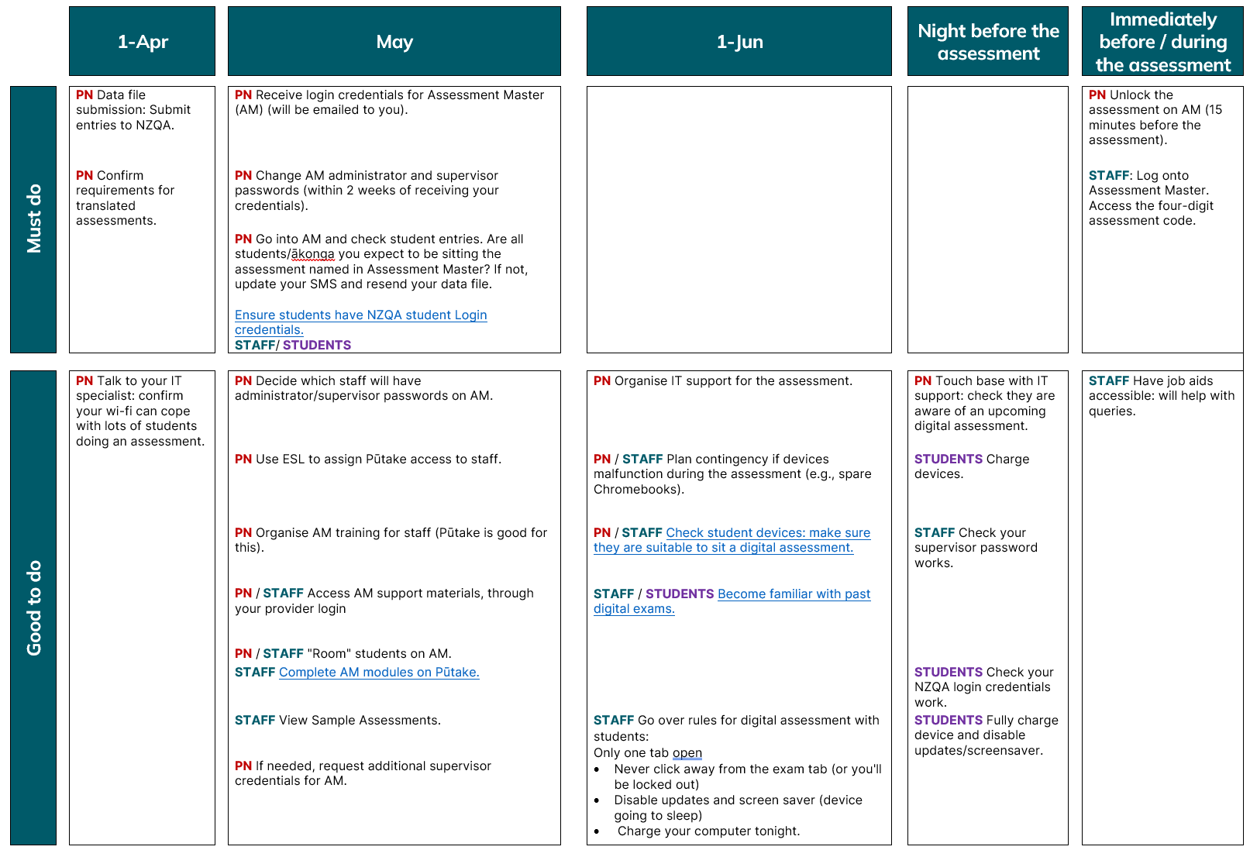

Slide 17
Getting your school ready for LITNUM | TRMTP summary:
How many students? Now
Check your school calendar and book venue(s) Now
Enter students via your SMS (include 'Sort Key’) Term 1 if poss.
Meet with key staff Before Term 1 holidays
Inform students, parents and staff Term 1 if possible
Familiarize yourself with Assessment Master (AM) Term 2
Prepare students Term 2

